Slide 1


Slide 2

Midterm #3 Review Sections 09/010
TA: Greydon Gilmore
Physiology 2130
Feb 24th, 2020

Slide 3
www.greydongilmore.com
Courses > Phys 2130 > at bottom of page

Slide 4

Your TA Reminding You….
3rd Midterm – Feb 28th @ 6pm (15%)
4th Assignment – Mar 27th (1.5%)
Post 2 MC questions: Mar 25th @ midnight
3rd Quiz – due Feb 25th @ 4pm (1%)
Opens: Feb 24th @ 4pm
Closes: Feb 25th @ 4pm
4th Quiz – due March 31st @ 4pm (1%)
Opens: March 30th @ 4pm
Closes: March 31st @ 4pm

Slide 5
Midterm Information
When: Feb 28th from 6pm-7pm
What: 35 multiple choice
Renal Physiology – 17 questions
Respiratory Physiology – 14 questions
GI physiology – 4 questions
Where: TBD

Slide 6
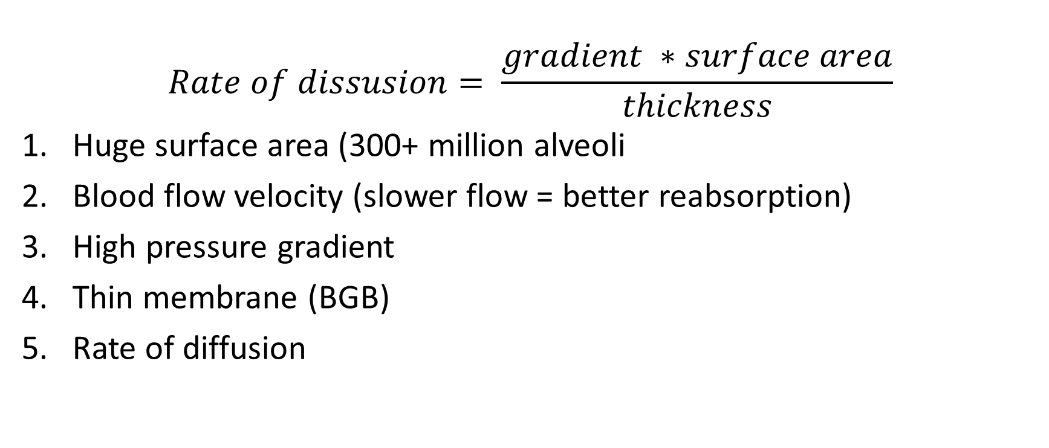
Factors that minimize simple diffusion (p. 307)
$$Rate of dissusion= \frac{gradient ∗surface area}{thickness}$$
Huge surface area (300+ million alveoli
Blood flow velocity (slower flow = better reabsorption)
High pressure gradient
Thin membrane (BGB)
Rate of diffusion

Slide 7
Effects of Changing Ventilation (p. 324)
Changing ventilation affects arterial PO₂, PCO₂ and pH
Holding breath without changing metabolic activity
PO₂
PCO₂ ( H⁺ = pH)
Hyperventilating without changing metabolic activity
PO₂
PCO₂ ( H⁺ = pH)
Increase metabolic activity without changing ventilation
PO₂
PCO₂ ( H⁺ = pH)
Less O₂ coming in at alveolar capillaries,
Less CO₂ leaving at alveolar capillaries (i.e. build up in blood)
More O₂ coming in at alveolar capillaries,
More CO₂ leaving at alveolar capillaries (i.e. less in blood)
More O₂ leaving at systemic capillaries (i.e. less in blood),
More CO₂ entering at systemic capillaries

Slide 8
Chapter 8: Renal 17 Questions on Exam
Professor: Dr. Woods

Slide 9
Overview of Chapter
Renal anatomy
Glomerular filtration
Transport mechanisms
Water and sodium handling
No Renin System
ANP

Slide 10
Kidney Anatomy
Two kidneys that sit posterior and outside of abdominal cavity (i.e. retroperitoneal)
Cortex = outer portion
Medulla = inner portion
Fluid collected into minor calyces → major calyces → renal pelvis → ureter
Renal artery carries blood to kidneys
Renal vein carries blood away from kidneys

Slide 11
Nephron Organization In The Kidney
Renal corpuscle located in cortex
Loop of Henle projects into and out of renal medulla
4-5 nephrons share a collecting duct
Collecting ducts drain into minor calyx
In 3D, the ascending limb is found near the glomerulus

Slide 12
Types of Nephrons
 | Juxtamedullary Nephron | Cortical Nephron
# in Kidney | Few | Many
Ability to concentrate urine | Good | Bad
Ability to filter blood | Good | Good
Location of Corpuscle in Cortex | Low | High
Loop of Henle | Long | Short
Capillaries | Vasa recta | Peritubular

Slide 13
Renal Corpuscle
Glomerulus: Group of fenestrated capillaries
Fenestrations allow passage of many substances (ions, water, etc.) into Bowman’s space (except red/white blood cells)
Cells of Bowman’s capsule (outer layer) are simple squamous epithelial cells
Cells of Bowman’s capsule (inner layer) are called podocytes
Cells of glomerular capillaries are called endothelial cells
Endothelial cells are fused with podocytes by basal lamina

Slide 14
Renal Corpuscle
JGA: part of ascending Loop of Henle, containing macula densa
Macula Densa: detect changes in Na⁺ and Cl⁻ levels in filtrate, cause vasoconstriction of afferent arteriole.
Granular Cells: release renin

Slide 15
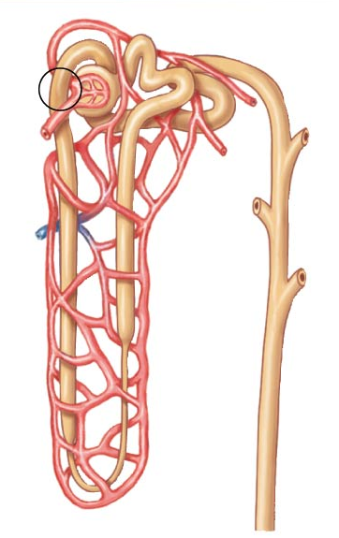
Blood Flow to the Kidneys
Efferent Arteriole
Glomerulus
Blood flow to organs
Heart → Artery → Arteriole → Capillary →
Venule → Vein → Heart
Blood flow to kidneys
Heart → Artery → Arteriole → Capillary →
Arteriole → Capillary → Venule → Vein → Heart
From Renal Artery
Afferent Arteriole
Venule
Peritubular Capillaries
To Renal Vein

Slide 16
Barriers to Filtration
Size of glomerular gaps/fenestrations
Gaps in basal lamina
Space between podocytes

Slide 17
Barriers to Filtration
Of all the blood that arrives at kidney, only 20% is filtered
Net filtration pressure (NFP): Sum of forces that affect filtration
NFP > 0 : filtration
NFP ≤ 0 : no filtration
 | Hydrostatic Pressure of Glomerular Capillaries | Colloid Osmotic Pressure of Glomerular Capillaries | Hydrostatic Pressure of Bowman’s Capsule | Colloid Osmotic Pressure of Bowman’s Capsule
Abbreviation | P_{GC} | π_{GC} | P_{BC} | π_{BC}
Caused by | Blood flowing into glomerulus | Presence of proteins in glomerulus | Filtrate remaining in Bowman’s space | Presence of proteins in Bowman’s space
Filtration | Promotes | Inhibits | Inhibits | Promotes
mmHg | 55 | 30 | 15 | 0

Slide 18
NFP Calculation
NFP = Promotes Filtration – Inhibits Filtration
= (P_{GC}+ π_{BC}) – (P_{BC}+ π_{GC})
= (55 + 0) – (15 + 30)
= 10 mmHg
 | P_{GC} | π_{GC} | P_{BC} | π_{BC}
Filtration | Promotes | Inhibits | Inhibits | Promotes
mmHg | 55 | 30 | 15 | 0

Slide 19
Glomerular Filtration Rate (GFR)
Volume of fluid filtered per day by the kidneys
Normal: 180 L/day (125 ml/min)
Important to maintain a constant GFR throughout the day
Affected by:
Net Filtration Pressure (NFP)
Mostly affected by renal blood flow and pressure (P_{GC})
Filtration Coefficient
Mostly affected by podocytes and basal lamina

Slide 20
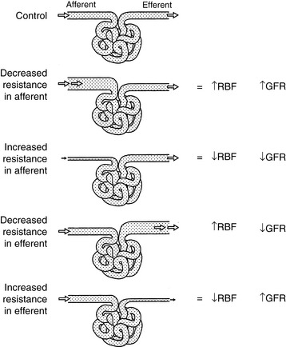
GFR Regulation: Overview
Both the myogenic response and tubuloglomerular response are used to increase and decrease GFR
Their combined goal is to mediate a constant GFR throughout the day
 | Afferent Arteriole |  | Efferent Arteriole
Smooth Muscle | Dilate | Constrict | Dilate | Constrict
GFR

Slide 21
GFR Regulation: Myogenic Response
Arterial blood pressure
Afferent arteriolar blood pressure
Afferent arteriole stretches
Sensing by stretch sensitive ion channels (opening)
Depolarization of smooth muscle open voltage-gated Ca²⁺ channels
Smooth muscles of afferent arteriole contraction
Vasoconstriction
Blood flow in glomerulus

Slide 22
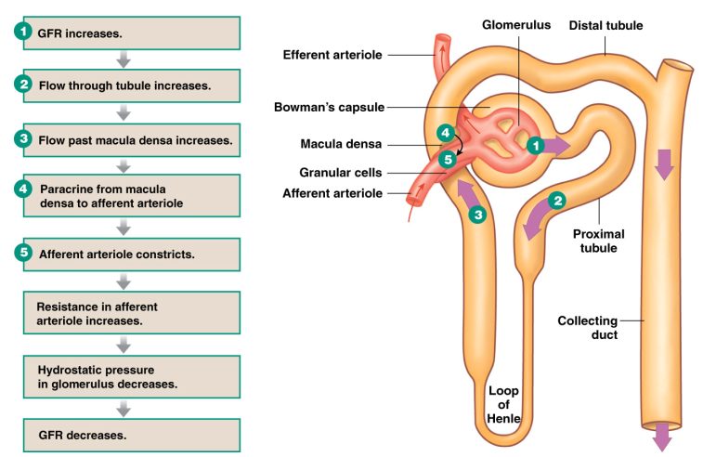
GFR Regulation: Tubuloglomerular feedback

Slide 23
Measurement of GFR
In order to measure GFR, you want to choose a substance that is excreted, but not reabsorbed
Bad substances: glucose, ions, water
Best substance: creatinine
Rate of creatinine excretion from the body is equivalent to GFR
GFR (L/day) = ([Creatinine]_{urine} x Urine/day ) / [Creatinine]_{plasma}
= (90 mg/L x 2 L/day) / (1 mg/L)
= 180 L/day

Slide 24
Renal Handling
Example: Urea
Filtered Load of Urea = [Urea]_{plasma} x GFR = 0.31 x 180 = 56 g/day
% Excreted = (Amount Excreted/Filtered Load) x 100% = (28/56) x 100% = 50 g/day
% Reabsorbed = 100 -% Excreted = 100 –50 = 50%
Substance | Concentration (in plasma) | Filtered Load | Amount Excreted | % Excreted | % Reabsorbed
Sodium | 3.5 g/L | 630 g/day | 3.2 g | 0.5% | 99.5%
Glucose | 1.0 g/L | 180 g/day | 0 g | 0% | 100%
Urea | 0.31 g/l | 56 g/day | 28 g | 50% | 50%

Slide 25
What is true regarding reabsorption in the kidney?
all potassium is reabsorbed in the collecting duct
glucose is reabsorbed by a type of primary active transporter
all sodium is reabsorbed by a protein carrier transporter
water reabsorption can be both paracellular and transcellular in the proximal tubule

Slide 26
What is true regarding reabsorption in the kidney?
all potassium is reabsorbed in the collecting duct
glucose is reabsorbed by a type of primary active transporter
all sodium is reabsorbed by a protein carrier transporter
water reabsorption can be both paracellular and transcellular in the proximal tubule

Slide 27
What is true regarding the action of hormones on the nephron?
anti-diuretic hormone (ADH) increases sodium reabsorption in the proximal tubule
aldosterone increases sodium reabsorption in the collecting duct
angiotensinogen increases sodium reabsorption in the collecting duct
angiotensin II increases water reabsorption in the proximal tubule

Slide 28
What is true regarding the action of hormones on the nephron?
anti-diuretic hormone (ADH) increases sodium reabsorption in the proximal tubule
aldosterone increases sodium reabsorption in the collecting duct
angiotensinogen increases sodium reabsorption in the collecting duct
angiotensin II increases water reabsorption in the proximal tubule

Slide 29
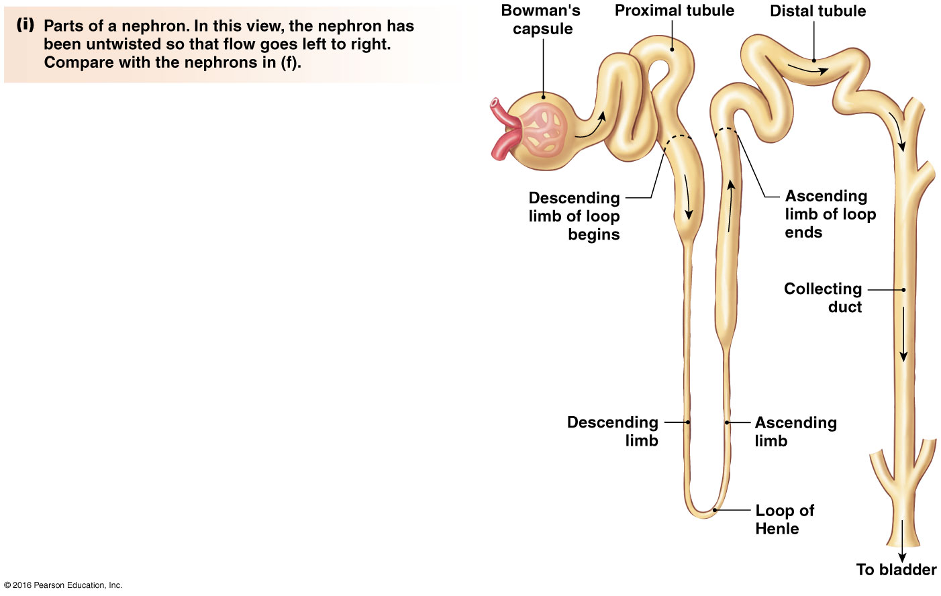
Reabsorption Along The Tubule
65% volume reabsorbed
Segment of Tubule | Substances | Hormone Regulation | Percent
Proximal Tubule | Glucose, H₂O, Na⁺, K⁺, Cl⁻ | Yes | 65%
Descending Limb of LOH | H₂O and minimal Na⁺ | No | 20 %
Ascending Limb of LOH | Na⁺, K⁺, Cl⁻ | No
Distal Tubule | Na⁺, K⁺, Cl⁻ , Ca²⁺ | Yes | 14%
Collecting Duct | H₂O, Na⁺ | Yes
14% volume reabsorbed
20% volume reabsorbed

Slide 30
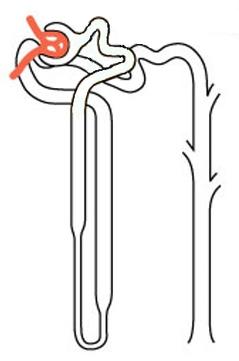
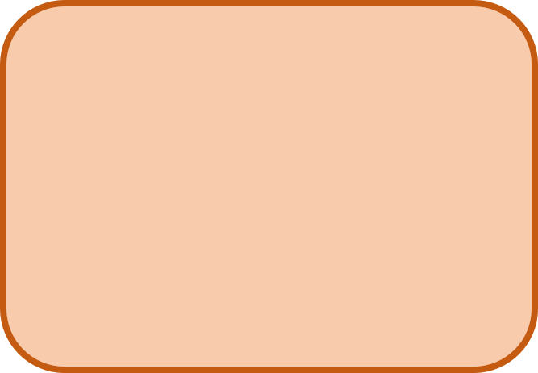
Proximal Tubule
Na⁺/Amino Acid Symporter: Uses Na⁺ gradient to carry an amino acid across luminal membrane against its concentration gradient
Na/H+Antiporter/Exchanger:
Uses Na gradient to carry H+
across luminal membrane into filtrate
Na⁺/Glucose Symporter: Uses Na⁺ gradient to carry glucose across luminal membrane against its concentration gradient
H⁺
Paracellular Transport
Na⁺
Amino
Acid
Na⁺
Glucose
H₂O
Na⁺
Aquaporin 1 (AQ1): Water Channel
Amino Acid Uniporter: Carries amino acid across basolateral membrane down its concentration gradient
Aquaporin 1 (AQ1): Water Channel
K⁺
ATP
Na/K ATPase: Maintains concentration gradients needed to drive transport of other molecules
Glucose Uniporter: Carries glucose across basolateral membrane down its concentration gradient
Na⁺
Amino
Acid
Glucose
H₂O
H₂O, Cl⁻, K⁺
Blood vessel near proximal tubule

Slide 31
Proximal Tubule Hormonal Control
Angiotensin II
H⁺
Paracellular Transport
Na⁺
Amino
Acid
Na⁺
Glucose
H₂O
Na⁺
K⁺
ATP
Na⁺
Amino
Acid
Glucose
H₂O
H₂O, Cl⁻, K⁺
Blood vessel near proximal tubule

Slide 32
RAAS
Angiotensin Converting Enzyme
Large (452 aa) protein
No function
Smaller (10 aa) protein
No function
Small (8 aa) protein
Function: Hormone
Released by JG cells
Due to Na
***Rate Limiting Step***
Angiotensin II can only be made if renin is present

Slide 33
Angiotensin II
Made by cleavage of:
angiotensinogen angiotensin I angiotensin II
Peptide hormone (= requires cell-surface receptor on luminal membrane)
Stimulus
Release of renin by JG cells due to Na⁺
Goal
Increase Na⁺ reabsorption in proximal tubule
How
Increase activity of Na⁺ /H⁺ exchanger and Na⁺ /K⁺ ATPase in proximal tubule
Decrease GFR by constricting afferent arteriole

Slide 34
Renin
Renin released due to low sodium levels

Slide 35
Descending LOH
Overall Goal:
REABSORPTION
Aquaporin 1 (AQ1): Water Channel
H₂O
H₂O
H₂O
Aquaporin 1 (AQ1): Water Channel
H₂O
H₂O
H₂O
Other Key Points:
Only Na⁺ Reabsorption, no other ions
No Paracellular Transport
No Hormonal Regulation

Slide 36
Ascending LOH
Overall Goal:
REABSORPTION
Paracellular Transport
Na⁺
Na⁺
K⁺
2Cl⁻
K⁺
ATP
Na⁺
K⁺
Cl⁻
Na⁺
Other Key Points:
No Water Reabsorption
No Hormonal Regulation

Slide 37
Distal Convoluted Tubule
Overall Goal:
REABSORPTION
Parathyroid
Hormone
Na⁺
Na⁺
K⁺
2Cl⁻
Ca²⁺
K⁺
Na⁺
ATP
Na⁺
K⁺
Cl⁻
Ca²⁺
Other Key Points:
No Water Reabsorption
No Paracellular Transport

Slide 38
Which of the following is a transporter that increases activity in the presence of aldosterone?
sodium/potassium ATPase in the proximal tubule
sodium/potassium ATPase in the collecting duct
sodium/hydrogen exchanger in the proximal tubule
sodium/hydrogen exchanger in the collecting duct

Slide 39
Which of the following is a transporter that increases activity in the presence of aldosterone?
sodium/potassium ATPase in the proximal tubule
sodium/potassium ATPase in the collecting duct
sodium/hydrogen exchanger in the proximal tubule
sodium/hydrogen exchanger in the collecting duct

Slide 40
Collecting Duct
Overall Goal:
Fine Tuning of H₂O Na⁺ Reabsorption
Aquaporin 2 (AQ2)
Na⁺
K⁺
H₂O
K⁺
ATP
Aldosterone
Aquaporin 3 and 4 (AQ3 and AQ4)
Na⁺
H₂O
ADH

Slide 41
Aldosterone
Made by adrenal gland
Steroid hormone (= intracellular receptor)
Stimulus
Angiotensin II, High K⁺, ACTH
Goal
Increase Na⁺ reabsorption in collecting duct
How
Na⁺ and K⁺ channels in luminal membrane: by translocation and protein expression
Na⁺ /K⁺ ATPase activity and protein expression

Slide 42
Anti-Diuretic Hormone (aka Vasopressin)
Made by hypothalamus (by neuroendocrine cells)
stored/released by posterior pituitary
Peptide hormone (= requires cell-surface receptor on basolateral membrane)
Stimulus
High plasma osmolarity = Low ECF volume = Low BP
Goal
water reabsorption = ECF volume = BP

Slide 43
Anti-Diuretic Hormone (aka Vasopressin)
plasma osmolarity (fluid is hyperosmotic)
Osmoreceptors (in hypothalamus) shrink
ADH is released from posterior pituitary
Travels in blood to collecting duct
Binds to receptors on basolateral membrane
Increases # of AQ2 channels on luminal membrane
water reabsorption

Slide 44
Anti-Diuretic Hormone (aka Vasopressin)
BV = BP
Baroreceptors (in aortic arch and carotid sinus) fire less AP to hypothalamus
ADH is released from posterior pituitary
Travels in blood to collecting duct
Binds to receptors on basolateral membrane
Increases # of AQ2 channels on luminal membrane
water reabsorption = BV = BP

Slide 45
Atrial Natriuretic Peptide (ANP)
Made by cardiac atrial cells
Peptide hormone
Stimulus
High blood pressure
Goal
Decrease Na⁺ reabsorption
How
Inhibits aldosterone secretion by adrenal glands
Dilates afferent arterioles → increasing GFR
This increases flow of filtrate through tubule, leads to increase in Na⁺ excretion

Slide 46
Atrial Natriuretic Peptide (ANP)
blood volume, high Na⁺ and high ECF volume
Distension of cardiac atria
Atrial myocardial cells release ANP
Kidney - Afferent arteriole dilated
Adrenal Cortex
Increased GFR
Inhibits aldosterone
Increased Na⁺ excretion

Slide 47
Based on the following information, what segment of the tubule is being described?
Incapable of paracellular transport
No water reabsorption
Some hormonal control
Proximal tubule
Ascending limb of the loop of Henle
Distal convoluted tubule
Collecting duct

Slide 48
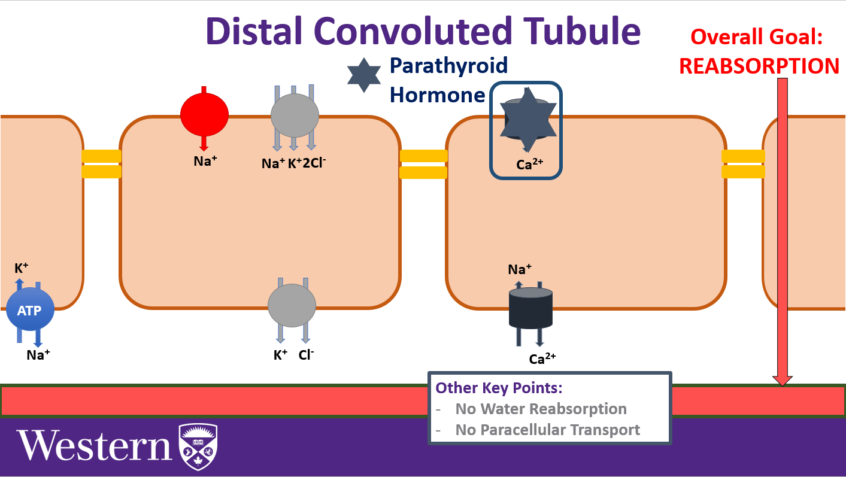
Based on the following information, what segment of the tubule is being described?
Incapable of paracellular transport
No water reabsorption
Some hormonal control
Proximal tubule
Ascending limb of the loop of Henle
Distal convoluted tubule
Collecting duct

Slide 49
Summary of Transport
 | Proximal Tubule | Descending Limb | Ascending Limb | Distal Tubule | Collecting Duct
Goal | Reabsorption of everything | Water reabsorption | Ion reabsorption | Ion reabsorption | Fine tuning (water and Na)
Water | Yes | Yes | No | No | Yes
Ions | Yes (Na⁺, Cl⁻, K⁺) | Minimal (Na⁺) | Yes (Na⁺, Cl⁻, K⁺) | Yes (Na⁺, Cl⁻, K⁺, Ca²⁺) | Yes (Na⁺)
Paracellular Transport | Yes | No | Yes | No | No
Hormone Regulation | Angiotensin II | - | - | PTH | Aldosterone ADH

Slide 50
Summary of Hormonal Regulation
Hormone | Made By | Hormone Type | Stimulus | Response
Renin | Kidneys | N/A | Increased sodium | N/A
Angiotensin II | Angiotensin Converting Enzyme | Peptide | Renin – released due to low sodium | Increase sodium reabsorption in proximal tubule: Increase activity of Na⁺ /H⁺ exchanger and Na⁺ /K⁺ ATPase Constrict afferent arteriole (decreasing GFR)
Aldosterone | Adrenal Gland | Steroid | Angiotensin II and high K⁺ | Increase sodium reabsorption in collecting duct: Increase Na⁺ and K⁺ channels in luminal membrane Increase activity of Na⁺ /K⁺ ATPase
Atrial Natriuretic Peptide | Cardiac atrial cells | Peptide | High blood pressure | Decrease sodium reabsorption: Inhibit aldosterone secretion from adrenal glands Dilates afferent arteriole (increasing GFR)

Slide 51
Chapter 9: Respiratory 14 Questions on Exam
Professor: Dr. Beye

Slide 52
Overview of Chapter
Anatomy of respiratory system
Lung volume measurements
Partial pressures and gas exchange
Carbon dioxide transport

Slide 53
Lung Anatomy
Left Lung
2 Lobes
Why? The heart sits on the left side of thoracic cavity
Right Lung
3 Lobes

Slide 54
Lung Anatomy
Muscles
Intercostal muscles (between ribs)
Diaphragm (bottom)
Pleural Layers
Visceral pleura (against lungs)
Intrapleural space/cavity
Parietal pleura (against chest wall)
Visceral = Very close
Parietal = Pretty close

Slide 55
Lung Anatomy
Respiratory tract can be divided into two sections:
Conducting Zone
Respiratory Zone

Slide 56
Zones of Respiratory Tract

Slide 57
Conducting Zone
Trachea
Primary Bronchus
(Left and Right)
2⁰ Bronchi
3⁰ Bronchi
Bronchioles
Terminal Bronchioles
“Conducting zone terminates at terminal bronchioles”

Slide 58
Conducting Zone
Functions
Transport air to lungs
Filter, warm and moisten air
Microbial defense:
Bronchial epithelial cells are ciliated
Cilia sweeps mucus with trapped micro-organisms towards the trachea
Smoking reduces function of cilia

Slide 59
Respiratory Zone
Respiratory Bronchioles
Alveolar Ducts
Alveolar Sacs
Alveoli
“Respiratory zone begins at respiratory bronchioles”

Slide 60
The walls of the alveoli are composed of two types of cells, type I and II. The function of type II is to ______.
Secrete surfactant
Trap dust and other debris
Replace mucus in the alveoli
Protect the lungs from bacterial invasion

Slide 61
The walls of the alveoli are composed of two types of cells, type I and II. The function of type II is to ______.
Secrete surfactant
Trap dust and other debris
Replace mucus in the alveoli
Protect the lungs from bacterial invasion

Slide 62
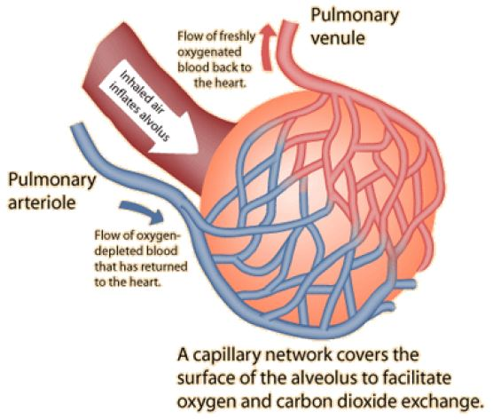
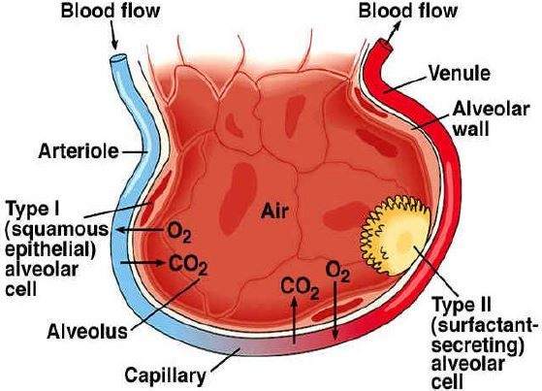
Respiratory Zone
Function
Gas exchange in the alveoli at the blood gas barrier
CO² leaves blood supply into air
O² leaves air into blood supply
Cells
Type 1 cell: flat and thin cells that form alveolar wall and allow for easy gas exchange between alveoli and capillary
Type 2 cell: secrete surfactant
Macrophages: destroy microorganisms

Slide 63
A 200 pound 20 year old man has a tidal volume of 500 mL and a respiratory rate of 10 breaths per minute. What is his anatomical dead space ventilation per minute?
5 liters
2 liters
3000 Ml
200 mL
V_{D}= Weight x Respiratory Rate

Slide 64
A 200 pound 20 year old man has a tidal volume of 500 mL and a respiratory rate of 10 breaths per minute. What is his anatomical dead space ventilation per minute?
5 liters
2 liters
3000 Ml
200 mL
V_{D}= Weight x Respiratory Rate
= 200 X 10
= 2000 mL → 2 Litres

Slide 65
Ventilation Calculations
Tidal Volume: Amount of air entering lungs in one breath during normal inhalation
Respiratory Rate: # of breaths per minute
Pulmonary Ventilation (V_{E}): Amount of air entering lungs (both zones) per minute
V_{E} = Tidal Volume x Respiratory Rate
Anatomical Dead Space Ventilation (V_{D}): Amount of air not involved in gas exchange (Anatomical dead space = 1 mL/pound)
V_{D} = Weight x Respiratory Rate
Alveolar Ventilation (V_{A}): Amount of air entering only the respiratory zone per minute
V_{A} = V_{E} - V_{D}

Slide 66
Ventilation Calculations
Example: For a 150 lb individual with respiratory rate of 30 breaths/min and tidal volume of 200 mL/breath
V_{E} = Tidal Volume x Respiratory Rate
= 200 x 30
= 6000 mL/min
V_{D} = Weight x Respiratory Rate
= 150 x 30
= 4500 mL/min
V_{A} = V_{E} – V_{D}
= 6000 – 4500
= 1500 mL/min
By changing your pattern of breathing, you can alter how much air is actually available for gas exchange (V_{A})

Slide 67
You head out for a run. About 5 minutes in, you notice you are breathing pretty hard. What is happening in your thoracic cavity?
your external intercostals are contracting during exhalation
your diaphragm is relaxing during inhalation
your intrapulmonary pressure will match the atmospheric pressure during exhalation
your internal intercostal muscles will pull your ribcage down and inwards during exhalation

Slide 68
You head out for a run. About 5 minutes in, you notice you are breathing pretty hard. What is happening in your thoracic cavity?
your external intercostals are contracting during exhalation
your diaphragm is relaxing during inhalation
your intrapulmonary pressure will match the atmospheric pressure during exhalation
your internal intercostal muscles will pull your ribcage down and inwards during exhalation

Slide 69
Inhalation
Diaphragm and external intercostal muscles contract (Diaphragm moves down and intercostals pull ribcage up and out)
Thoracic cavity expands (Increase volume)
Decrease intrapulmonary pressure by Boyle’s law (<760 mmHg)
Air moves in

Slide 70
Exhalation (Passive)
Diaphragm and external intercostal muscles relax (Diaphragm moves up and ribcage gets smaller)
Thoracic cavity decreases in volume
Increase intrapulmonary pressure by Boyle’s law (>760 mmHg)
Air moves out

Slide 71
Exhalation (Active - Exercise)
Diaphragm and external intercostal muscles relax
Internal intercostals, obliques and rectus abdominus contract
Thoracic cavity decreases in volume
Increase intrapulmonary pressure by Boyle’s law (>760 mmHg)
Air moves out

Slide 72
During active exhalation (exercise), which of the following muscles are contracting?
1. Obliques
2. Diaphragm
3. Internal intercostals
4. External intercostals
A. 1, 2 and 3 are correct
B. 1 and 3 are correct
C. 2 and 4 are correct
D. Only 4 is correct
E. All are correct

Slide 73
During active exhalation (exercise), which of the following muscles are contracting?
1. Obliques
2. Diaphragm
3. Internal intercostals
4. External intercostals
A. 1, 2 and 3 are correct
B. 1 and 3 are correct
C. 2 and 4 are correct
D. Only 4 is correct
E. All are correct

Slide 74
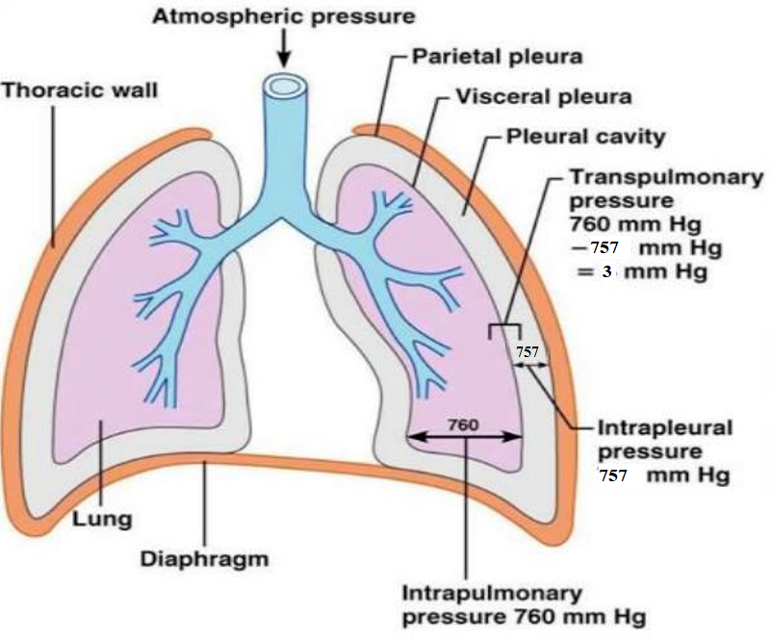
Intrapleural and Transpulmonary Pressure
Intrapleural Pressure: Pressure in intrapleural space; 757 mmHg
Prevents lung from collapsing at the end of expiration
Allows for easy expansion of the lung
Transpulmonary Pressure: Pressure across the lung; +3 mmHg
Intrapulmonary Pressure (760) – Intrapleural Pressure (757)

Slide 75
Lung Compliance
Compliance is the “stretchability” of the lung
Compliance = Change in volume / Change in pressure
Affected by 2 factors:
Elastic tissue of lungs (33%)
Caused by presence of elastin and collagen
Surface tension in alveoli (66%)
Surfactant reduces surface tension
An increase in these 2 factors decreases compliance and increases likelihood of lung collapse

Slide 76
Pulmonary Surfactant
Released by type 2 cells
Layer is spread across air-water interface in alveoli
Surfactant = phospholipids + proteins
Phospholipids: hydrophilic head towards water; hydrophobic head towards air
Proteins: help with microbial defense
Functions:
Reduce surface tension
Improve compliance and prevent alveolar collapse
Improves microbial defense function
Proteins help identify foreign particles for macrophages
Neonatal respiratory distress syndrome (nRDS): premature infants lack mature surfactant system, which leads to poor lung function, alveolar collapse and hypoxemia (treatment = surfactant)

Slide 77
If in one breath a person takes in a larger tidal volume than they normally would, which one of the following statements would be correct?
they are likely be breathing in less than 500 mL (0.5 litres)
they would have a smaller IRV (inspiratory reserve volume)
they would have a larger total lung capacity
they would have a smaller FEV1

Slide 78
If in one breath a person takes in a larger tidal volume than they normally would, which one of the following statements would be correct?
they are likely be breathing in less than 500 mL (0.5 litres)
they would have a smaller IRV (inspiratory reserve volume)
they would have a larger total lung capacity
they would have a smaller FEV1

Slide 79
Spirometry
IRV (3L): Max volume of air that can be inhaled after a normal inspiration
VC (4.5L): TV + IRV + ERV
ERV (1L): Max volume of air that can be exhaled after a normal inspiration
TV (0.5L): Volume of air moved into or out of lungs during normal breathing
TLC (6L):
TV + IRV + ERV + RV
RV (1.5L): Volume of air remaining in lungs after a max expiration

Slide 80
What is true of a restrictive lung disease?
Emphysema is an example of a restrictive lung disease
Lungs can become floppy due to Loss of elastin
FEV1 decreases
FVC decreases

Slide 81
What is true of a restrictive lung disease?
Emphysema is an example of a restrictive lung disease
Lungs can become floppy due to Loss of elastin
FEV1 decreases
FVC decreases

Slide 82
Other Lung Measurements
Forced vital capacity (FVC): how much air a person can exhale as fast as possible during a forced breath
Forced expiratory volume (FEV₁): volume of exhalation over 1 second
FEV₁
FVC
Normal | Obstructive | Restrictive
FEV1 | Decreases | No Change
FVC | No Change | Decreases
FEV1/FVC = 80 % | FEV1/FVC < 80% | FEV1/FVC > 80%

Slide 83
Lung Diseases: Obstructive
Air flow obstruction during exhalation
Diameter of bronchioles decreases (lumen constricted)
 | Cause | Effect
Asthma | Spasms triggered by exercise, air pollution and allergies | Airway inflammation and hyper-responsiveness
Chronic Bronchitis | Smoking | Excessive mucus and inflammation
Emphysema | Smoking | Alveolar wall break down creates large air sacs ( surface area = poor gas exchange) Loss of elastin reduces elastic recoil ( compliance so lungs fill but can’t empty)

Slide 84
Lung Diseases: Restrictive
Air flow restriction during inhalation
 | Cause | Effect
Pulmonary Fibrosis | Chronic inhalation of asbestos, coal, dust, pollution or sometimes unknown | Fibrous scar tissue (thickened tissue) in alveoli and other lung tissue Due to thick walls, poor gas exchange (similar to emphysema but different reason) Lungs become stiff due to in collagen = compliance (opposite to emphysema)

Slide 85
In the pulmonary vein, what is the PO2 for a person at rest?
40 mmHg
46 mmHg
100 mmHg
159 mmHg

Slide 86
In the pulmonary vein, what is the PO2 for a person at rest?
40 mmHg
46 mmHg
100 mmHg
159 mmHg

Slide 87
Erthropoiesis
Process of producing new RBCs (2 million made and die each day)
Occurs in bone marrow
Regulated by the hormone, erythropoietin (EPO) from kidneys
Normally, EPO levels are low for balanced RBC production to loss ratio
When O₂ levels to kidney drop, EPO is released
Drop in O₂ can be caused by:
in # of RBCs ( carrying capacity)
in cardiac output ( blood flow = O₂)
lung disease
high altitude

Slide 88
Regulation of Ventilation
Stimulus: Altered PO₂ and PCO₂ levels
Sensors: Chemoreceptors sense change in P
Control centre: Info is sent to respiratory centre in medulla
Effector: Respiratory muscles change force of contraction and relaxation to alter pulmonary ventilation
Effect: PO₂ and PCO₂ levels return to normal

Slide 89
Chemoreceptors
 | Central | Peripheral
Location | Medulla | Aortic arch and carotid body
Respond to changes in | pH only Note: H⁺ cannot cross the blood brain barrier, but CO₂ can. So CO₂ is converted into bicarbonate and H⁺ in CSF for detection | PO₂ PCO₂ pH

Slide 90
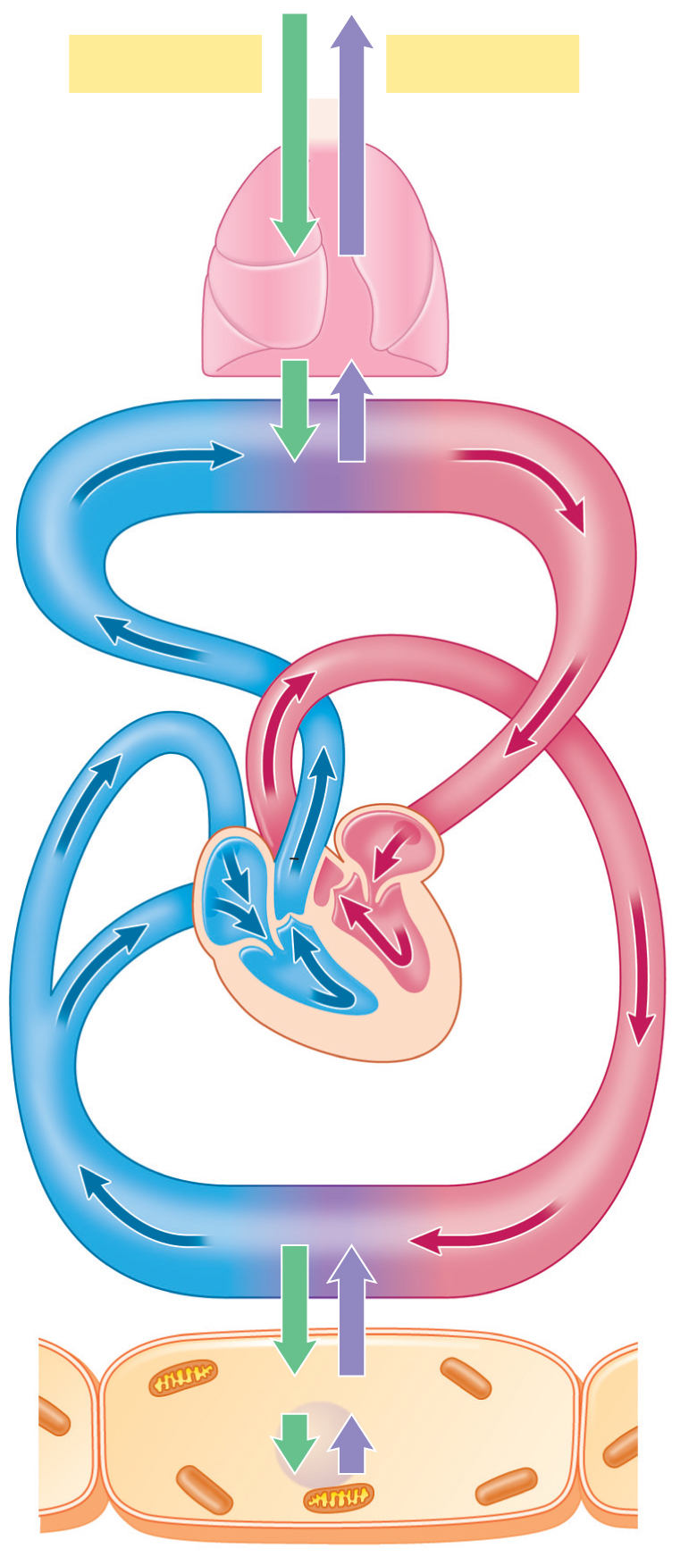
Gases move from high pressure to low pressure
Gases move until equilibrium
Gases only move at capillaries
Atmospheric PO₂ = 160 mmHg
Atmospheric PCO₂ = 0.3 mmHg
Alveolar PO₂ = 100 mmHg
Alveolar PCO₂ = 40 mmHg
O₂ enters capillaries from alveoli
Pulmonary artery
PO₂ = 40 mmHg
PCO₂ = 46 mmHg
Pulmonary circulation
capillaries
Pulmonary vein
PO₂ = 100 mmHg
PCO₂ = 40 mmHg
CO₂ enters alveoli from capillaries
Systemic veins
Venous PO₂ = 40 mmHg
Venous PCO₂ = 46 mmHg
Systemic arteries
Arterial PO₂ = 100 mmHg
Arterial PCO₂ = 40 mmHg
Systemic circulation
capillaries
Body tissues
Tissue PO₂ = 40 mmHg (or less)
Tissue PCO₂ = 46 mmHg (or more)
CO₂ enters capillaries from body tissues
O₂ leaves capillaries into body tissues

Slide 91
Oxygen Transport
Two Transport Mechanisms in Blood
Dissolved in plasma (1.5%)
Very inadequate
Carried by hemoglobin (98.5%)
O₂ + Hb ↔ HbO₂ (oxyhemoglobin)
Hb is found in RBCs
4 heme groups (each Fe binds a O₂) + 4 globins (polypeptide chain)
Note: Hb transports BOTH O₂ and CO₂ (at different sites!)

Slide 92
Carbon Dioxide Transport
Three Transport Mechanisms in Blood
Dissolved in plasma (10%)
More soluble than O₂
Carried by hemoglobin (20%)
CO₂ + Hb ↔ HbCO₂ (carbamino hemoglobin)
Attached to “globin” not heme
Bicarbonate form (70%)
CO₂ + H₂O ↔↔↔ H₂CO₃ ↔ ↔ ↔HCO₃⁻ + H⁺
Carbonic anhydrase is an enzyme found in RBCs
carbonic
anhydrase
proton
carbonic
acid
bicarbonate

Slide 93
Oxyhemoglobin Dissociation Curve
How to read this graph:
A resting cell (40 mmHg), Hb is 80% saturated with O₂
An exercising cell (20 mmHg), Hb is 25% saturated with O₂
At alveoli (100 mmHg), Hb is 98% saturated with O₂
The steep slope means that a small change in PO₂ drastically effects Hb saturation
Thus, at lungs, Hb is highly saturated with O₂. At tissues, Hb is releasing O₂.

Slide 94
Oxyhemoglobin Dissociation Curve
Bohr Effect
In the presence of CO₂ or protons, Hb has a decreased affinity for oxygen
The curve shifts to the RIGHT
Example: now at 40 mmHg, Hb is decreased from 80% to 60% saturation with O₂
In other words, a right shift promotes O₂ offloading
Thus, during exercise (when temp, CO₂ and H⁺ levels are high), more O₂ is delivered to tissues

Slide 95
Oxyhemoglobin Dissociation Curve
At Body tissues:
CO² begins to bind & form bicarbonate and proton
Curve shifts to right
This enhances O₂ off loading at tissues
At Lungs:
Blood passing through lungs gives up CO₂ & H⁺ ions in the form of carbonic acid
Bicarbonate will combine with the proton to form CO₂ and water and CO₂ will diffuse out of the blood stream at the lungs
This shifts O₂ dissociation curve to left
During this process the pH will increase and the affinity for oxygen by Hb will increase, allowing for binding of O₂

Slide 96
Shift Right = Decreased Affinity and increased off-loading

Slide 97
Shift Left = Increased Affinity

Slide 98
Bohr Effect
In the presence of CO₂ or protons, Hb has a decreased affinity for oxygen
CO₂ + H₂O ↔ H₂CO₃ ↔ HCO₃⁻ + H⁺
Within the red blood cells CO₂ is converted to bicarbonate
The pH of blood will change and cause the O₂ dissociation curve to shift right, causing more O₂ offloading at tissues
carbonic
anhydrase
proton
carbonic
acid
bicarbonate

Slide 99
Chloride Shift
As CO₂ leaves body tissue it enters the red blood cells
CO₂ is converted into bicarbonate in the red blood cell and a proton is formed
The pH will decrease and oxygen affinity of Hb will decrease, allowing off-loading into the tissues
As bicarbonate exits the red blood cell a chloride molecule will enter to maintain the charge balance
To maintain an electrically neutral state

Slide 100
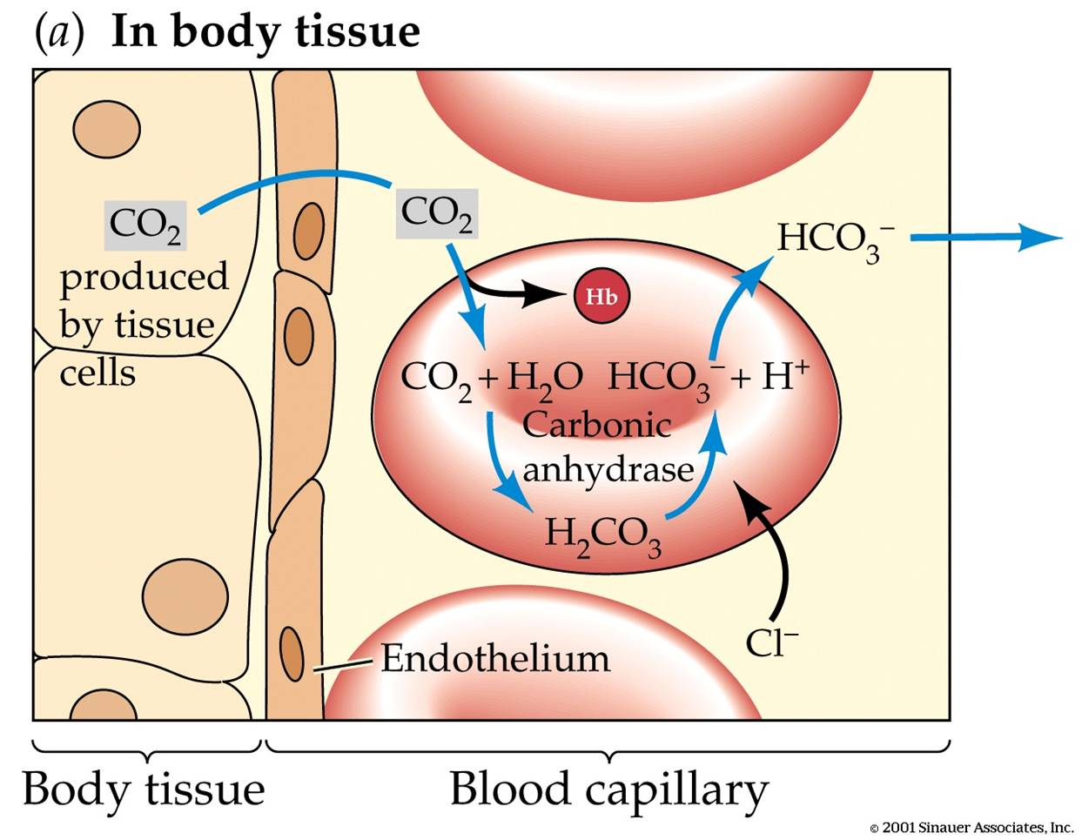
Chloride Shift: Body Tissues

Slide 101
Chloride Shift: At Lungs
Takes place in reverse
CO₂ + H₂O ↔ H₂CO₃ ↔ HCO₃⁻ + H⁺
At pulmonary capillaries, the bicarbonate ion will enter the red blood cell and a chloride will leave the red blood cell
Bicarbonate will combine with the proton to form CO₂ and water and CO₂ will diffuse out of the blood stream at the lungs
During this process the pH will increase and the affinity for oxygen by Hb will increase, allowing for binding of O₂

Slide 102
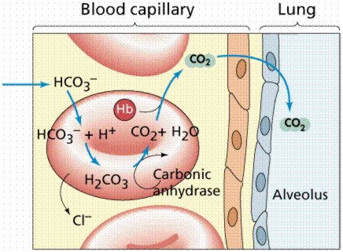
Chloride Shift: At Lungs

Slide 103
Intro to Gastrointestinal Physiology
Chapter 10: Dr. Woods

Slide 104
Four Processes of Digestive System
Secretion
Exocrine into lumen of GI tract
Endocrine into blood
Digestion
Chemical (enzymes)
Mechanical
Motility
Propels food through each segment of GI tract
Can participate in mechanical digestion
Absorption
Movement of macronutrients into cells of GI tract and then into blood

Slide 105
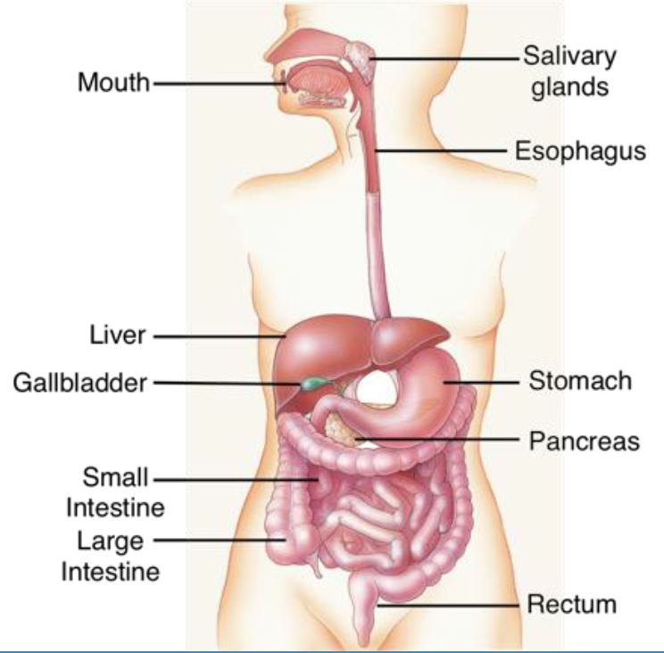
GI Tract
Main pathway
Mouth and salivary glands
Esophagus
Stomach
Small Intestine
Large Intestine
Rectum
Accessory Organs
Liver (produces bile)
Gall bladder (stores biles)
Common bile duct
Pancreas (endocrine and exocrine secretions)

Slide 106
Salivary Glands
Function
Produce saliva (water, mucus, ions and salivary amylase; lipase in babies)
Parotid Gland
Watery liquid that contains amylase and lingual lipase
Submandibular Gland
Thicker liquid that contains mucus with less amylase and less lingual lipase
Sublingual Gland
A lot of mucus and very little enzymes

Slide 107
Mastication, Swallowing and Peristalsis
Mastication
Mechanical manipulation of food into a lump of food (bolus)
Swallowing → 3 Stages:
Voluntary stage
Pharyngeal stage (involuntary): propagation of food into pharynx; close trachea and nasal cavity
Esophageal (involuntary): propagation of food into esophagus
Peristalsis
Movement of bolus down the esophagus by contraction of muscles
Involuntary control by medulla
Second peristaltic wave if food is still lodged

Slide 108
Mouth: Summary of Four Processes
Secretion
Saliva
Digestion
Chemical (amylase and lipase)
Mechanical (mastication)
Motility
Mastication in mouth
Peristalsis in esophagus
Absorption
None

Slide 109
Stomach
Function
Reservoir for food before entering intestines for absorption
Bolus is liquefied by gastric juices
2-3 L of gastric juices secreted into stomach per day

Slide 110
Layers of The Stomach
Mucosa
Single layer of cells that can be endocrine or exocrine
Large folds called rugae and invaginations called pits
Submucosa
Nervous plexus: submucosal plexus (detects food in stomach and sends signals to mucosa for response)
Connective tissue to adhere mucosa to smooth muscle
Smooth muscle (Muscularis externa)
Circular and longitudinal muscle to change shape of the stomach
Nervous plexus: myenteric plexus (controls muscle)
Serosa
External layer of dense connective tissue

Slide 111
Secretions In The Stomach
Exocrine
Cell | Secretion | Function
Mucus Neck Cells | Mucus | Protects stomach from acid
Chief Cells | Pepsinogen | Inactive enzyme
 | Gastric Lipase | Breakdown fats
Parietal Cells | Intrinsic Factor | Allows absorption of vitamin B12
 | HCL acid | See slide 10.
Endocrine
Cell | Secretion | Function
G Cell | Gastrin | Promotes gastric motility and function

Slide 112
Mechanical Digestion in the Stomach
Gentle mixing waves(every 15-25 seconds), pyloric sphincter closed
Vigorous mixing from body to pylorus
Slight opening of pyloric sphincter, very small amount of chyme exits to the duodenum (retropulsion)
Most chyme pushed back into stomach body for more mixing

Slide 113
Chemical Digestion in the Stomach
HCl (parietal cells) cleaves pepsinogen (chief cells) to pepsin
Pepsin: protein digestion
Gastric lipase (chief cells; activated by HCl): lipid digestion
Lingual lipase (activated by HCl): lipid digestion
Salivary amylase (inactivated by HCl): carbohydrate digestion stops

Slide 114
HCl Acid in the Stomach
Functions:
Activation of pepsin
Activation of lingual and gastric lipase
Inactivation of salivary amylase
Kills microbes
Denatures proteins
Stimulates secretion of hormones

Slide 115
Anatomy of the Small Intestine
Duodenum
Location of enzymes mixing with chyme, most digestion occurs here
Can increase or decrease motility to optimize chemical digestion
Jejunum
Many villi to increase surface area for optimal absorption
Most absorption occurs here
Ileum
Less villi but can still absorb nutrients if necessary

Slide 116
Layers of the Small Intestine
4 layers (similar to stomach)
Mucosa
Submucosa
Submucosal plexus
Muscularis externa
Myenteric plexus
Serosa
SI has villi and microvilli that increases surface area for absorption
Note: villi in SI ≠ rugae in stomach

Slide 117
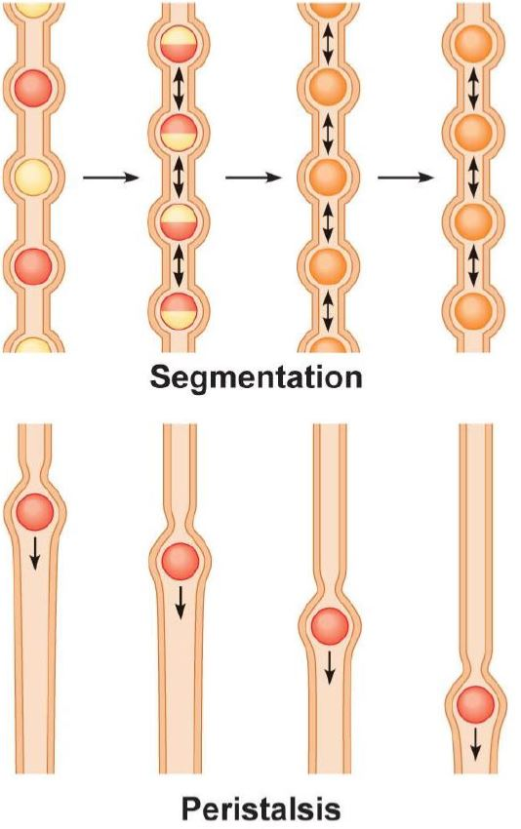
Motility of the Small Intestine
Segmentation
Localized contractions for mixing chyme with digestive juices
Increases the interactions of particles of food in chyme with absorptive cells of the mucosa layer
Peristalsis
Propels chyme forward to next portion of SI (from pyloric sphincter to large intestine)

Slide 118
Cells in the Small Intestine
Exocrine
Cell | Secretion | Function
Goblet Cells | Mucus | Protects small intestine from acid
Intestinal Gland cells | Intestinal Juice (alkaline) | Neutralize acid from stomach
Paneth Cells | Lysozyme | Anti-bacterial enzyme
Endocrine
Cell | Secretion | Function
S Cell | Secretin | Stimulates release of bicarbonate from pancreas
CCK Cells | CCK: Cholecystokinin | Stimulates release of enzymes from pancreas and bile from gallbladder
K cells | GIP: Glucose Dependent Insulinotriphic peptide | Stimulates insulin release from the pancreas

Slide 119
What Questions Do You Have?
You can ask in the Owl forums as well!
Also anonymously ask questions in the online dropbox!!

